Slide 1


WORK AND CANNABIS:
They Just Don’t Mix
Notes:
Now that Cannabis use is legal in Canada (for certain ages, depending on the province or territory), it’s important to know how cannabis impairment can affect your ability to work safely. Although it may be legal for recreational use, when it comes to work, the reality is that work and cannabis just don’t mix.

Slide 2

What is Cannabis?
Comes from one of two plants:
  Cannabis sativa
  Cannabis indica
Contains chemical compounds called “cannabinoids”
  For example: THC, CBD
Notes:
Most of have us heard of cannabis – or pot, marijuana, weed – but not everyone knows about what it contains, how it’s used, and the effects it can have on us. First off, let’s look at what Cannabis is:
The cannabis plant originally comes from Asia. It is now grown around the world, including in Canada.
The most commonly grown/used plants are Cannabis sativa and Cannabis indica
Cannabis contains Over 400 chemical compounds, of which 60 are cannabinoids
E.g.,
- THC: responsible for the “high”/intoxication one feels
- Cannabidiol (CBD) does not produce a high or intoxication
Source: Health Canada (https://www.canada.ca/en/health-canada/services/drugs-medication/cannabis/about.html#a1)

Slide 3
How is Cannabis Used?
Reasons for using cannabis:
  Effects on the mind (high, intoxication, calming)
  Medical, social, or religious purposes
Can be taken in different ways:
  Smoking, drinking, eating, vaporizing
Notes:
So why do people use cannabis?
The cannabis plant is used for its effects on the mind.
It is also used for medical, social or religious purposes.
Cannabis can be taken in different ways, by:
Smoking (joints, pipes, bongs, etc.)
Drinking/eating (teas, sodas, cannabis oil, baked goods)
Vaporizing/vaping (breathing in cannabis vapours through a vaporizer or vaping device)”
Source: Health Canada (https://www.canada.ca/en/health-canada/services/drugs-medication/cannabis/about.html#a1)

Slide 4

Cannabis Use in Canada
Canadian Cannabis Survey (2018)
Who is using cannabis?
  22% of survey respondents (ages 16+) had used cannabis in the past 12 months
  Ages 16-24: Use is twice that of 25+
  Average age of first cannabis use: 19 years
Notes:
In 2018, a sample of Canadians completed an online survey about their cannabis use. Surveys like this one help to give us an idea of how maybe people are using cannabis, and how often they are using it.
In total, there were 12,958 respondents aged 16 years and older across all provinces and territories
22% of respondents reported having use cannabis for non-medical purposes within the past 12 months
16-24 years of age: reported cannabis use in the past year at a percentage that was double that of people 25 years and older
Specifically, past 12-month use of cannabis among people aged 16 to 19 years and people aged 20 to 24 was 36% and 44%, respectively, compared to 19% for people aged 25 years and older
Source: https://www.canada.ca/en/services/health/publications/drugs-health-products/canadian-cannabis-survey-2018-summary.html

Slide 5

Cannabis Use in Canada
Canadian Cannabis Survey (2018)
How often?
  Daily: 19%
  3 days/month or less: 55%
  1 day/month or less: 35%
Notes:
Survey respondents who reported using cannabis over the past 12 months were asked how frequently they used the substance.
A little over half of these respondents reported using cannabis three days per month or less (55%), and 19% reported daily cannabis use.
The most common response was less than one day per month (35%), followed by daily (19%), two to three days per month (14%), one to two days per week (10%), three to four days per week (10%), one day per month (6%), and five to six days per week (6%). These were all unchanged from the previous cycle.
Source: https://www.canada.ca/en/services/health/publications/drugs-health-products/canadian-cannabis-survey-2018-summary.html

Slide 6

Cannabis Use in Canada
Cannabis use to get “high” before/at:
School
  Never: 53%
  Rarely: 27%
  Weekly: 12%
Work:
  Never: 64%
  Rarely: 15%
  Weekly: 8%
Notes:
Respondents who reported using cannabis over the past 12 months were also asked whether they used cannabis to get high before or at school or work.
School:
Of the students surveyed, 53% of had not used cannabis to get "high" before or at school in the past 12 months.
27% reported rarely using cannabis before or at school (less than once a month).
12% reported using cannabis before or at school weekly or more often.
Work:
The majority of respondents (64%) had not used cannabis to get "high" before or at work in the past 12 months.
15% reported using cannabis before or at work rarely (less than once a month).
8% used cannabis before or at work weekly or more often.
Source: https://www.canada.ca/en/services/health/publications/drugs-health-products/canadian-cannabis-survey-2018-summary.html

Slide 7
Possible Effects of Cannabis
Possible short-term effects:
Positive/Pleasant | Negative/Unpleasant
Feeling “high” (euphoria) | Confusion
Sense of well-being | Sleepiness
Relaxation | Trouble concentrating, remembering
Heightened sensory experiences (sight, taste, smell, sound, touch) | Anxiety, fear or panic
 | Damaged blood vessels (smoking)
 | Increased heart rate
 | Paranoia, delusions, hallucinations
Notes:
There are several possible effects of cannabis. Some of these are considered to be short-term effects, and some are considered to be long-term.
The possible effects of cannabis are individualized – it can affect each person in a variety of ways. Some of the most common short term effects are:
(Review table of short-term effects, using additional detail information below if needed)
Short-term health effects
feeling high (euphoria)
a sense of well-being
relaxation
heightened sensory experiences: sight, taste, smell, sound, touch
While cannabis may make you feel relaxed and happy, your body and brain may also experience effects that are:
negative
unwanted
unpleasant
Some of the possible short-term effects on your brain can include:
confusion
sleepiness (fatigue)
impaired ability to: remember, concentrate, pay attention, or react quickly
anxiety, fear or panic
Short term effects on your body can also include:
damaged blood vessels cause by the smoke (when smoking cannabis)
decreased blood pressure, which can cause people to faint
increased heart rate, which can be dangerous for people with heart conditions and can lead to an increased risk of heart attack
Cannabis use can also result in psychotic episodes characterized by:
paranoia
delusions
hallucinations
Source: https://www.canada.ca/en/health-canada/services/drugs-medication/cannabis/health-effects/effects.html#a1

Slide 8

Possible Effects of Cannabis
Possible long-term health effects (daily/weekly use that continues over weeks/months/years):
  Increased risk of addiction
  Impairment to memory, concentration, intelligence
  Bronchitis, lung infections, chronic cough (smoking)
Effects appear to be worse if you:
  Start using early in adolescence
  Use frequently for a long time
Notes:
While many people notice the short-term effects of cannabis soon after using it, the long effects develop gradually over time, with daily or near-daily weekly use over the course of:
weeks
months
years
The possible long-term effects of cannabis on your brain can include an increased risk of addiction. Long-term cannabis use can also harm your:
memory
concentration
intelligence (IQ)
ability to think and make decisions
These effects can last from several days, to months, or longer after you stop using cannabis. They may not be fully reversible even when cannabis use stops.
Other long-term effects of smoking cannabis are similar to the effects of smoking tobacco. These effects can include risks to lung health, such as:
bronchitis
lung infections
chronic (long-term) cough
increased mucus buildup in the chest
According to research, the long-term effects appear to be worse if you:
start using in early adolescence
use frequently and over a long period of time
Source: https://www.canada.ca/en/health-canada/services/drugs-medication/cannabis/health-effects/effects.html#a1

Slide 9

Medical Cannabis
Potential therapeutic uses:
  Chemotherapy-induced nausea and vomiting
  Multiple sclerosis
  Chronic pain
  Anxiety and depression
  Sleep disorders
  Inflammation
  Irritable bowel syndrome
NOTE:
Cannabis is not an approved therapeutic product unless the product has a drug identification number and is prescribed by a doctor
Notes:
Some people are prescribed cannabis by their doctor for medical purposes. There are a number of conditions for which a doctor may prescribe cannabis. Some examples include:
Chemotherapy-induced nausea and vomiting
Multiple sclerosis
Chronic pain
Anxiety and depression
Sleep disorders
Inflammation
Irritable bowel syndrome
It’s important to remember that cannabis is only considered a therapeutic product if it prescribed by a doctor and if the product has a drug identification number.
https://www.canada.ca/en/health-canada/services/drugs-medication/cannabis/information-medical-practitioners/information-health-care-professionals-cannabis-cannabinoids.html#a4.0

Slide 10

Cannabis and the Law
The Cannabis Act says who can produce, distribute, sell and possess cannabis across Canada
Federal law: Adults 18 years and older can possess, share, buy, and grow cannabis
  In most provinces/territories, the legal age is 19
Where can cannabis be used?
  Provinces/territories have their own laws
    E.g., “Consuming cannabis in public is not permitted” (N.B.)
Notes:
There are laws on who can possess/use, produce, and distribute/sell cannabis. In Canada, the federal laws on cannabis are outlined in the Cannabis Act.
According to federal law, adults who are 18 years of age or older are legally able to:
possess up to 30 grams of legal cannabis
share up to 30 grams of legal cannabis with other adults
buy dried or fresh cannabis and cannabis oil from a provincially-licensed retailer
grow, from licensed seed or seedlings, up to 4 cannabis plants per residence for personal use
make cannabis products, such as food and drinks, at home as long as organic solvents are not used to create concentrated products
As of October 17, 2019, cannabis edible products and concentrates are legal for sale.
Although federal law says the legal age is 18, many provinces and territories have actually set their legal age at 19. There are also laws that are specific to each province or territory, so it’s important to be familiar with the laws where you live, and where you visit frequently.
Source: https://www.justice.gc.ca/eng/cj-jp/cannabis/
Provincial/territorial law: https://www.canada.ca/en/health-canada/services/drugs-medication/cannabis/laws-regulations/provinces-territories.html

Slide 11

Cannabis and the Law
Drugs, including cannabis, can impair your ability to drive by:
  Affecting motor skills
  Slowing reaction time
  Impairing short-term memory and concentration
  Causing drivers to vary speed and to wander, and
  Reducing the ability to make decisions quickly
In Canada, you can be charged criminally for operating a vehicle while impaired by alcohol or drugs
  Each province/territory has its own laws on impaired driving
Notes:
Driving while under the influence of drugs has been illegal in Canada since 1925. If you make the choice to drive while impaired by drugs, you are not only risking your life and others’ lives, but you also risk facing consequences such as having your license suspended, fines, criminal charges, or even jail time. Each province has its own laws on impaired driving.
Cannabis and other drugs can impair your ability to operate a motor vehicle in many ways. This is one example of how cannabis impairment can affect your safety.
http://www.rcmp-grc.gc.ca/ts-sr/aldr-id-cfa-aldr-eng.htm

Slide 12
Cannabis and the Law
Criminal Penalties
Offence | Penalties
Possession over the limit | Ticket for small amounts; up to 5 years less a day in jail
Illegal distribution or sale | Tickers for small amounts; up to 14 years in jail
Taking cannabis across Canada’s borders | Up to 14 years in jail
Giving or selling to a person under 18
Using a youth to commit a cannabis-related offence
Notes:
Besides impaired driving, there are other ways you could face criminal penalties with illegal possession or use of cannabis. Depending on the offense, you could face fines or even years in jail if you break the law on cannabis in your province or territory.
https://www.justice.gc.ca/eng/cj-jp/cannabis/

Slide 13

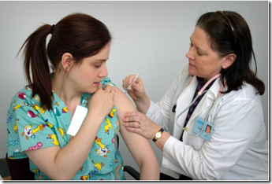

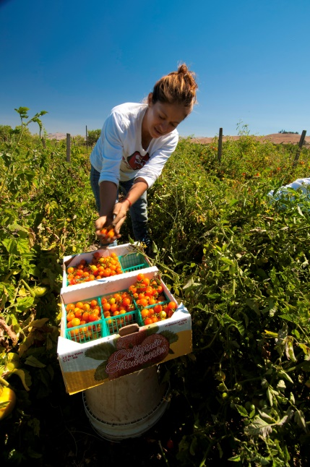


The World of Work
Think of a Workplace:
Notes:
Let’s switch gears, and focus on work. Think of a workplace, any workplace. Could be a hospital or clinic, a farm, a deli, a restaurant, a grocery store, a child care centre, etc.
(Ask for examples of workplaces – their own, their parents, etc)

Slide 14
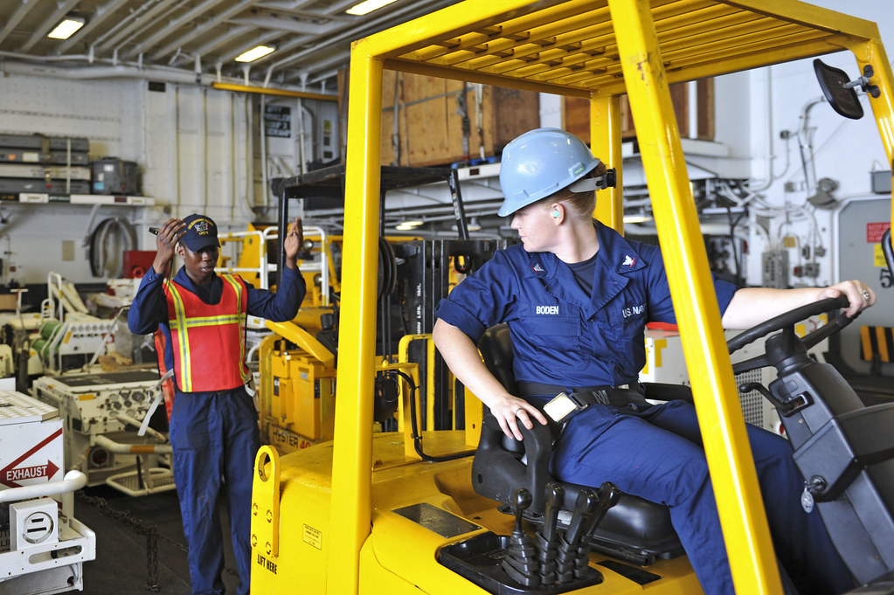
The World of Work
The workplace can be dangerous.
People can and do get hurt at work.
Notes:
Workplaces can be dangerous, some more than others. Already today, somewhere in Canada, a worker has been seriously injured in their workplace.
(Invite participants, who are willing, to share stories they have of workplace injuries)

Slide 15

Keeping Workplaces Safe
Many factors determine how safe a workplace is:
Type of work
Condition of equipment
Materials used
Procedures in place
Training and Supervision
Worker factors
Notes:
What makes one workplace more dangerous than another? Why might some workers have a higher chance than others of getting hurt at work?
There are many factors that determine how safe – or unsafe – a workplace might be.
(Review the factors, giving one or two examples for each.)
Type of workplace – a shoe store vs. a manufacturing plant;
Condition of equipment – a brand new saw with updated safety guards, vs. an old, outdated saw in poor working condition;
Materials used – handling food products vs. pesticides;
Procedures in place – written detailed safe work procedures vs. no formal procedures at all
Training and Supervision – formalized methodical training for all work processes vs. “learn as you go”
Worker factors – workers who come to work skilled, committed, and energetic vs. workers who come with few abilities, little commitment, and little energy
Consider which of the above factors are determined or influenced largely by an employer or supervisor. (type of work, condition of equipment, materials used, procedures in place, and training & supervision)
Which factors do workers have influence over?
“Let’s look more closely at workers, and what they bring to a workplace.”

Slide 16
Keeping Workplaces Safe
Many factors determine how safe a workplace is:
Type of work
Condition of equipment
Materials used
Procedures in place
Training and Supervision
Worker factors
Notes:
Let’s look more closely at workers, and what they bring to a workplace.
Of all the factors that determine how safe a workplace may be, the ones that workers have the most control over are – workers, themselves!
Workers have little or limited impact over the type of work that is done, the kind of equipment used, workplace procedures, or the kind of training they are given; what they can control – every day – is the selves they bring to work.
(Invite examples of what workers do have control over in their workplace each day – Answers may vary, depending on where they work, but might include: what they wear, what they bring for lunch, attitude, physical energy, a desire to be there, interest in others, a desire to learn and to perform their work well, etc.)

Slide 17
Worker Factors in Workplace Safety
Worker Quality | Ready to Work | Not Ready to Work
Skills and Abilities | Highly skilled | Incompetent
Attitudes | Positive | Negative
Ability to Focus | Focused | Easily distracted
Commitment | Attends to detail | Careless
Energy Level | Enough energy to get job done | Often tired
Notes:
“What qualities do workers bring each day that enhance workplace safety, or create an obstacle to workplace safety?”
Discuss the various ways these qualities could help to prevent an injury incident, or help to cause one.

Slide 18

Fit for Duty
We call someone who comes to work with their best physical, mental, and emotional self – ready to competently complete the tasks that are part of their job - “Fit for Duty.”
Notes:
There is a phrase we use that refers to a worker’s capacity (physically, mentally, and emotionally) to do their job safely and competently. That phrase is “Fit for Duty,” also sometimes referred to as “Fit for Work.”

Slide 19
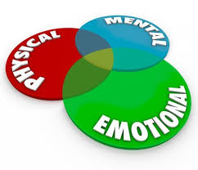
What does “Fit for Duty” mean?
“Fit for Duty” means to be in a physical, mental, and emotional state to safely perform the essential tasks of the work assignment
Notes:
Another definition of “Fit for Duty…”

Slide 20
Fit for Duty!
Physical State | Mental State | Emotional State
Strength | Ability to think clearly | Ability to cope with normal work stress
Endurance | Ability to work from memory | Ability to accept criticism
Reaction time | Ability to follow directions | Ability to focus on task at hand
Sense of balance | Ability to make wise decisions | Sense of calm and centredness
Steadiness of hand | Alertness and focus | Being engaged
Notes:
What are the various kinds of capacity or “ability to…” that workers are expected to bring to work with them each day, in order to safely and competently complete the tasks assigned them?
(Invite examples of task at work that might require some of these capacities.
Example: strength – moving furniture, landscaping, working with lobster traps; endurance – yardwork, refereeing a soccer game, construction; reaction time – operating machinery, driving vehicles, operating heavy equipment; ability to work from memory – food server, electrical task, etc)

Slide 21
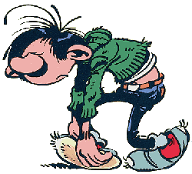
Impairment
A worker is considered “impaired” when their physical, mental, or emotional capacity to function is diminished.
What might cause
impairment in a worker?
Notes:
Next slide will answer this question, but leave a few minutes to see what students can suggest for each of the three categories – physical, mental, or emotional.

Slide 22
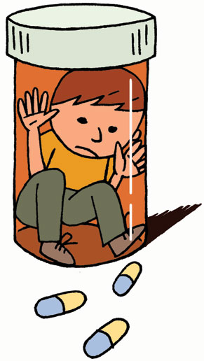

Possible Causes of Impairment
Fatigue
Drug use
Alcohol consumption
Extreme anxiety
Personal or family crisis
Notes:
There are many possible causes of impairment, the most common ones being:
Fatigue - could be caused by long hours of work, not enough sleep (because a person just didn’t go to bed at a good time), difficulty in or inability to sleep, shift work, illness, recovering from illness or injury, etc.,
Drug and alcohol use – prescribed, recreational, or illegal drug use; abuse of alcohol, after effects of drug or alcohol use
Stress and anxiety – often caused by life stresses and experiences, within or outside of the workplace (illness, loss, fear,) “Examples?”

Slide 23
Possible Causes of Impairment
Fatigue
Drug use, specifically cannabis
Alcohol consumption
Extreme anxiety
Personal or family crisis
Notes:
Bearing in mind that there are many causes of impairment at work, today’s focus is on cannabis use.
Let’s look at some of the ways cannabis use while at work or before going to work might cause a worker to be impaired.

Slide 24
Possible Effects of Cannabis
Possible short-term effects:
Positive/Pleasant | Negative/Unpleasant
Feeling “high” (euphoria) | Confusion
Sense of well-being | Sleepiness
Relaxation | Trouble concentrating, remembering
Heightened sensory experiences (sight, taste, smell, sound, touch) | Anxiety, fear or panic
 | Damaged blood vessels (smoking)
 | Increased heart rate
 | Paranoia, delusions, hallucinations
Notes:
A re-visit of the various possible effects of cannabis, suggests how cannabis use, before or during work hours, has the potential impair our physical, mental, and emotional ability to work safely. Who stands to lose if we work while impaired? (our employer, our co-workers, but - most significantly - ourselves)
https://www.canada.ca/en/health-canada/services/drugs-medication/cannabis/health-effects/effects.html

Slide 25

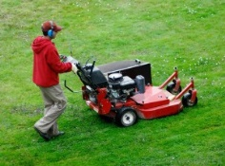

Activity 1
With a partner or a small group, discuss how cannabis impairment could impact your ability to work safely.
  Share your thoughts with the rest of the group.
Notes:
Activity 1 - See accompanying Student Assignment.
Distribute copies of the assignment to pairs of small groups of students, and allocate time for completion. Encourage use of whatever resources available.

Slide 26

OHS Legislation
“Employers must take every reasonable precaution to protect all at the workplace…”
AND
“Workers must do everything they can to protect their health and safety, and that of their co-workers.”
Notes:
Now that we’ve determined the extent to which cannabis can impact the safety of workers – both impaired workers, as well as those they work with – let’s review the legal responsibilities of employers to keep workers healthy and safe, and the responsibility of workers to stay safe.
Although the wording changes from one province/ territory to another, employer and worker responsibilities are basically the same throughout all of Canada; employers must ensure that every reasonable precaution is taken to protect the health and safety of all in the workplace.
And -
Workers must work safely, taking every reasonable precaution to protect their own health and safety, and that of their co-workers.
What can employers do to ensure that work and cannabis never mix?

Slide 27

Impairment Policy
Impairment Policy – one way employers strive to keep workplaces impairment-free
Have appropriate mechanisms in place,
Provide clear guidelines to all parties, and
Apply policies and programs fairly and consistently.
Notes:
Impairment Policy
Establishing an “Impairment Policy” – or a “Drug, Alcohol, and Medication Policy” – is one way employers try to ensure their workers report to work, able to carry out their duties without being a health and safety risk to themselves or to others.
Policies will vary from place to place, but must be well thought-out (taking into account the size and type of workplace, and other factors); clearly communicated to all parties (posted where everyone can refer to it, and staff informed about policy contents), and consistently followed by all.

Slide 28
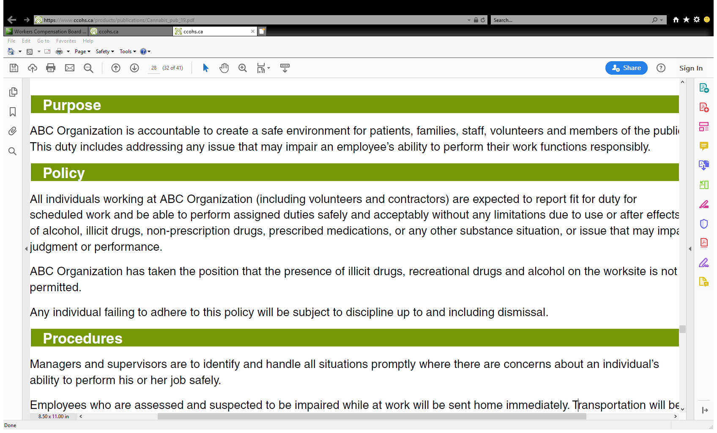
Sample Impairment Policy
wegfhgvbn
Notes:
This sample Impairment Policy states that:
“ABC Organization has taken the position that the presence of illicit drugs, recreational drugs and alcohol on the worksite is not permitted.
Any individual failing to adhere to this policy will be subject to discipline up to and including dismissal.”
Policies will differ from place to place, but will have common elements: a commitment to safety, rules, procedures, and consequences
Once a company has established a well-planned, and fair policy on drug and alcohol use, and has made sure that all staff are fully informed and trained on the policy contents, workers must adhere to the policy, or risk whatever disciplinary action has been outlined.

Slide 29
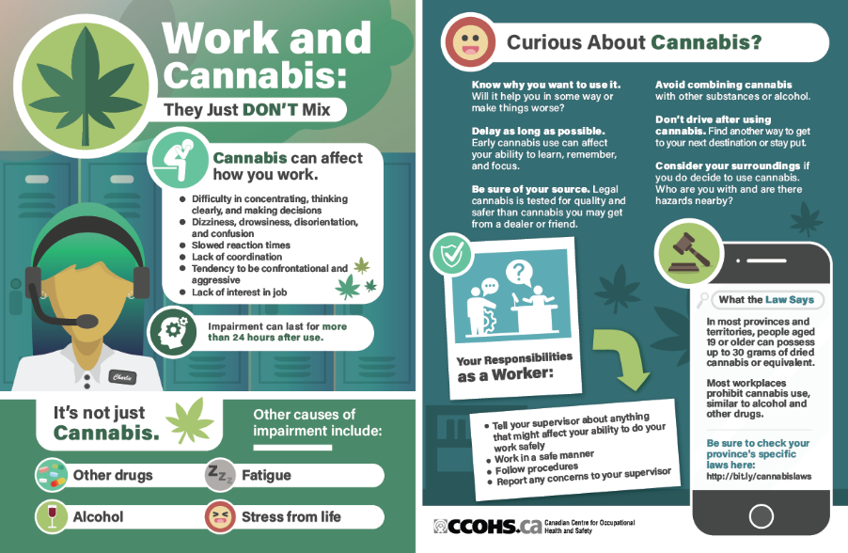
Activity 2
Create a poster to illustrate why work and cannabis don’t mix.
  Ask your teacher and/or employer for permission to display your poster at your school or workplace.
Notes:
Activity 2 – See reverse of Student Assignment for optional extension activity.

Slide 30
Conclusion
Employers and workers have responsibilities around working safely
Cannabis can impact worker safety
Work and cannabis: they just don’t mix
Notes:
Employers and workers have responsibilities around keeping workplaces safe for all.
Impairment can take many forms, including fatigue, extreme work stress, personal and family crisis, and substance use. There are many possible effects of cannabis use, many of which have a direct impact on one’s ability to work safely.
Employers establish impairment policies to outline for all staff their expectations around being fit for duty at all times in the workplace.
Everyone has the right to make choices about the various ways they spend their own time. When it comes to the time they spend in a workplace, however, some things are not up for personal choice. Anything that puts their health and safety, and that of co-workers at risk, has no place at work. Work and cannabis: they just don’t mix.”

